Slide 1
Chapter 2: my first application
Dr. Adeel Ansari

Slide 2
Important Topics in this chapter
HTTP Module
Create your own Module
Call your module
REPL environment
Node Packet Manager - NPM

Slide 3
Node.js – First application for web
Create a Node.js file named "myfirst.js", and add the following code:
The code tells the computer to write "Hello World!" if anyone (e.g. a web browser) tries to access your computer on port 8080.
var http = require('http'); http.createServer(function (req, res) { res.writeHead(200, {'Content-Type': 'text/html'}); res.end('Hello World!'); }).listen(8080);
Start your command line interface, write node myfirst.js and hit enter.
Now, your computer works as a server!
If anyone tries to access your computer on port 8080, they will get a "Hello World!" message in return!
Start your internet browser, and type in the address: http://localhost:8080

Slide 4
Description
A Node.js application consists of the following three important components:
Import required modules – We use the require directive to load Node.js modules.
Create Server – A server which will listen to client’s requests.
Read request and return response – The server created earlier will read the HTTP requests made by the client which can be a browser or a console and return the response.

Slide 5
Built-in HTTP Module
Node.js has a built-in module called HTTP, which allows Node.js to transfer data over the Hyper Text Transfer Protocol (HTTP).
To include the HTTP module, use the require() method:
var http = require('http');
or
const http = require('http');
The HTTP module can create an HTTP server that listens to server ports and gives a response back to the client.
Use the createServer() method to create an HTTP server:

Slide 6
HTTP Header
If the response from the HTTP server is supposed to be displayed as HTML, you should include an HTTP header with the correct content type:
var http = require('http'); http.createServer(function (req, res) { res.writeHead(200, {'Content-Type': 'text/html'}); res.write('Hello World!'); res.end(); }).listen(8080);
The first argument of the res.writeHead() method is the status code, 200 means that all is OK, the second argument is an object containing the response headers.

Slide 7
var http=require("http");
http.createServer(function(request,response){
response.writeHead(200,{'Content-Type':'text/plain'});
response.end('Hello world Test\n');
}).listen(8081);
console.log('Server running at http://127.0.0.1:8081/');
Use fat-arrow expressions to reduce the coding
const http=require('http');
http.createServer((req,res)=>{
res.writeHead(200,{'Content-type':'text/html'});
res.end('<h1>Hello NodeJS</h1>');
})
.listen(3000,()=>console.log('Server running on port 3000'));
Callback functions are executed later.

Slide 8
How to Exit a node.js program
There are various ways to terminate a Node.js application.
When running a program in the console you can close it with ctrl-C, but what we want to discuss here is programmatically exiting.
The process core module provides a handy method that allows you to programmatically exit from a Node.js program:
When Node.js runs this line, the process is immediately forced to terminate.
This means that any callback that's pending, any network request still being sent, any filesystem access, or processes writing to stdout or stderr - all is going to be ungracefully terminated right away.
process.exit().
Note: process does not require a "require", it's automatically available.

Slide 9
Node.js modules
Dr. Adeel Ansari

Slide 10
What is a Module in Node.js?
Consider modules to be the same as JavaScript libraries.
A set of functions you want to include in your application.
Modules are of two types:
Core: built-in modules that ship with NodeJS
File-based: User built/ downloaded

Slide 11
Create your own modules
You can create your own modules, and easily include them in your applications.
The following example creates a module that returns a date and time object:
exports.myDateTime = function () { return Date(); };
Use the exports keyword to make properties and methods available outside the module file.
Save the code above in a file called "myfirstmodule.js"

Slide 12
Include Your Own Module
Now you can include and use the module in any of your Node.js files.
const http = require('http'); var dt = require('./myfirstmodule'); http.createServer(function (req, res) { res.writeHead(200, {'Content-Type': 'text/html'}); res.write("The date and time are currently: " + dt.myDateTime()); res.end(); }).listen(8080);
Notice that we use ./ to locate the module, that means that the module is located in the same folder as the Node.js file.
Save the code above in a file called "demo_module.js", and initiate the file:

Slide 13
Try This
exports.hello=function(fullname){
console.log("Hi "+fullname+". The time is: "+new Date().getHours()+" Hours and "+ new Date().getMinutes() + " minutes!");
}

Slide 14
Try this
Save it as index.js file in the “enigma” folder.
exports.hello=(user)=>{
return "Hello "+user;
}
//the exports expression is a utility that prepares the function
//to be used by the outside world
exports.goodmorning=(user)=>{
return "Good Morning "+user;
}
Save it as app.js file outside the “enigma” folder.
const enigma=require('./enigma');
console.log(enigma.hello("Dave"));
console.log(enigma.goodmorning("Dave"));

Slide 15
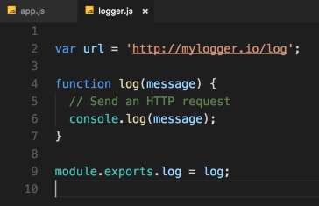
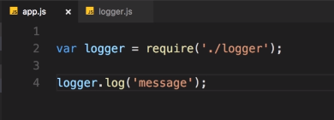

Try this
Type in command prompt: jshint filename.js
jshint is a tool to find errors in js file.
logger.js file
app.js file
Called by
run

Slide 16
Global objects
Dr. Adeel Ansari

Slide 17
Global Objects
Objects that are accessible anywhere in any file.
console.log() is a global object.
setTimeout()
clearTimeout()
setInterval()
clearInterval()
These objects belong to the window or global object => global.console.log()
Variables are not included in global object.

Slide 18
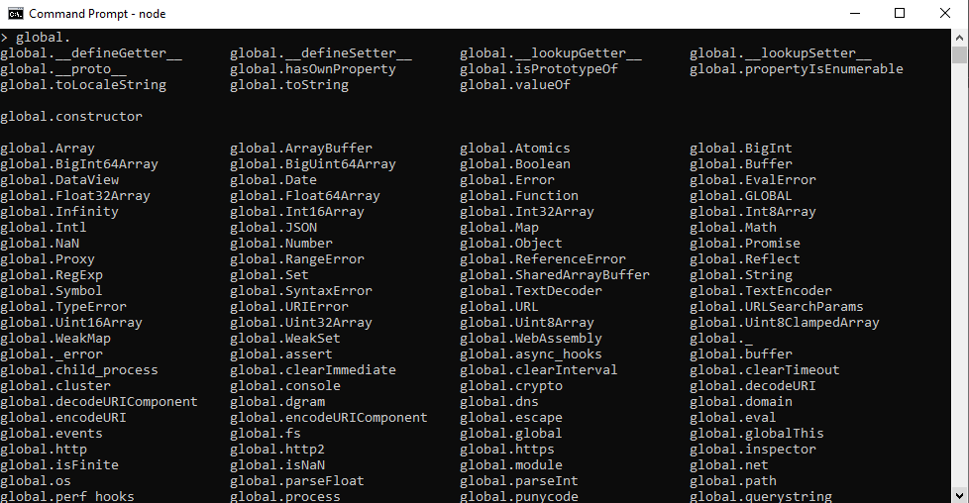
Global Objects
You can inspect the globals you have access to by typing global. and pressing tab:

Slide 19
Repl environment
Dr. Adeel Ansari

Slide 20
REPL Terminal
REPL stands for Read Eval Print Loop and it represents a computer environment like a Windows console or Unix/ Linux shell where a command is entered and the system responds with an output in an interactive mode. Node.js or Node comes bundled with a REPL environment. It performs the following tasks:
Read – Reads user’s input, parses the input into JavaScript data structure and stores in memory.
Eval – Takes and evaluates the data structure.
Print – Prints the result.
Loop – Loops the above command until the user presses CTRL+C twice.
The REPL feature of Node is very useful in experimenting with Node.js codes and to debug JavaScript codes.

Slide 21
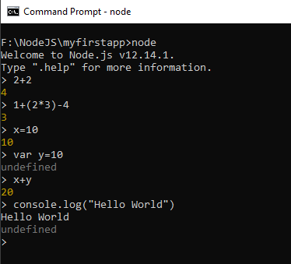
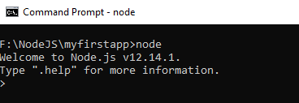
Starting REPL
REPL can be started by simply running “node” on shell/console without any arguments as follows:
You can perform mathematical operations, write loops and create variables here as well.

Slide 22
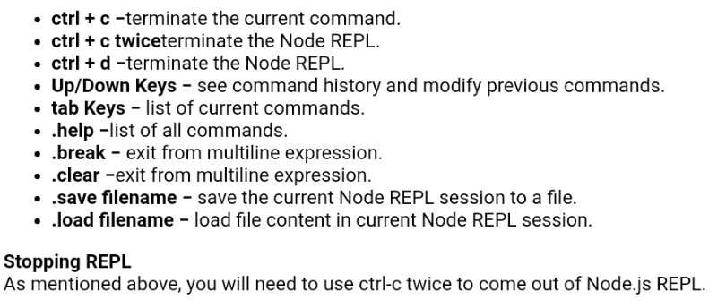
REPL Commands

Slide 23
Node.js console module
Dr. Adeel Ansari

Slide 24
Node.js console module
The Node.js console module provides a simple debugging console similar to JavaScript console mechanism provided by web browsers.
There are three console methods that are used to write any node.js stream:
1. console.log()
2. console.error()
3. console.warn()
The console.log() function is used to display simple message on console.
The console.error() function is used to display warning message on console.

Slide 25
Node.js console module

Slide 26
Node packet manager
Dr. Adeel Ansari

Slide 27
Node Packet Manager (NPM)
Node Package Manager (NPM) provides two main functionalities:
Online repositories for node.js packages/modules which are searchable on search.nodejs.org
Command line utility to install Node.js packages, do version management and dependency management of Node.js packages.
www.npmjs.com hosts thousands of free packages to download and use.
The NPM program is installed on your computer when you install Node.js

Slide 28
What is a package?
A package in Node.js contains all the files you need for a module.
Modules are JavaScript libraries you can include in your project.

Slide 29
Download a Package
Downloading a package is very easy.
Open the command line interface and tell NPM to download the package you want.
I want to download a package called “express“, type in command prompt:
npm install express
Now you have downloaded and installed your first package!
NPM creates a folder named "node_modules", where the package will be placed. All packages you install in the future will be placed in this folder.
My project now has a folder structure like this:
C:\Users\My Name\node_modules\express

Slide 30
How to Use a package
Now you can use this module in your js file as following:
var express = require('express');

Slide 31
Global vs. local installation
By default, NPM installs any dependency in the local mode. Here local mode refers to the package installation in node_modules directory lying in the folder where Node application is present. Locally deployed packages are accessible via require() method. For example, when we installed express module, it created node_modules directory in the current directory where it installed the express module.
Globally installed packages/dependencies are stored in system directory. Such dependencies can be used in CLI (Command Line Interface) function of any node.js but cannot be imported using require() in Node application directly. Now let's try installing the express module using global installation.
npm install express -g
This will produce a similar result but the module will be installed globally.

Slide 32
Global vs. local installation
You can use the following command to check all the modules installed globally:
npm ls -g
Alternatively, you can use npm ls command to list down all the locally installed modules.

Slide 33
Using package.json
package.json is present in the root directory of any Node application/module and is used to define the properties of a package.
Attributes of Package.json:
name - name of the package
version - version of the package
description - description of the package
homepage - homepage of the package
author - author of the package
contributors - name of the contributors to the package
dependencies - list of dependencies. NPM automatically installs all the dependencies mentioned here in the node_module folder of the package.
repository - repository type and URL of the package
main - entry point of the package
keywords - keywords

Slide 34
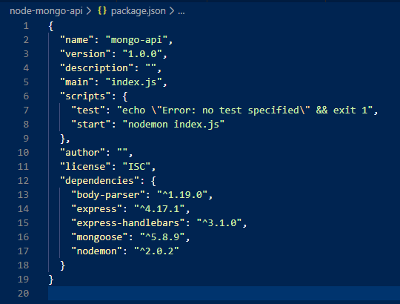
Package.json

Slide 35
Uninstalling a Module
Use the following command to uninstall a Node.js module.
npm uninstall express
Updating a Module
Update package.json and change the version of the dependency to be updated and run the following command.
npm update express

Slide 36
Create a Module
Creating a module requires package.json to be generated. Let's generate package.json using NPM, which will generate the basic skeleton of the package.json.
npm init
This utility will walk you through creating a package.json file. It only covers the most common items, and tries to guess sane defaults.

Slide 37
Class Activity
Activity 1:
Create a package.
Create 3 modules.
Create an index.js file that will utilize these 3 modules.
Activity 2:
Create a Web Server, using Express.

Slide 38
Summary
Creating a Web Server Basics:
const http = require('http'); http.createServer(function (req, res) { res.writeHead(200, {'Content-Type': 'text/html'}); res.write('Hello World!'); res.end(); }).listen(8080);

Slide 39
summary
Module
To create a module, create a function and export it:
exports.FunctionName=(message)=>{
return message;
}
To call the module, use "require()“:
const fn=require('./filename.js');
console.log(fn.FunctionName(message));

Slide 40
summary
REPL Environment
To enter into the REPL environment, use “node” keyword in command prompt.
To exit the REPL environment, use CTRL+C twice.
To save scripts in REPL, use “.save filename.js” method.
To load script in REPL, use “.load filename.js” method.

Slide 41
References
https://nodejs.dev/how-to-install-nodejs
https://www.w3schools.com/nodejs/nodejs_get_started.asp
https://www.udemy.com/course/all-about-nodejs/
https://www.udemy.com/course/nodejs-master-class/

